Slide 1
Lecture 3

Slide 2
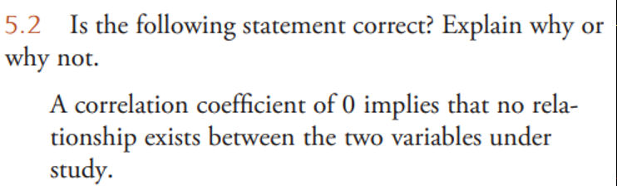
Important cautions

Slide 3
Important cautions
5.2
A correlation coefficient of 0 implies that there is no linear relationship between two variables. However, this is only for a linear relationship. It is possible that the variables have a strong non-linear relationship.

Slide 4
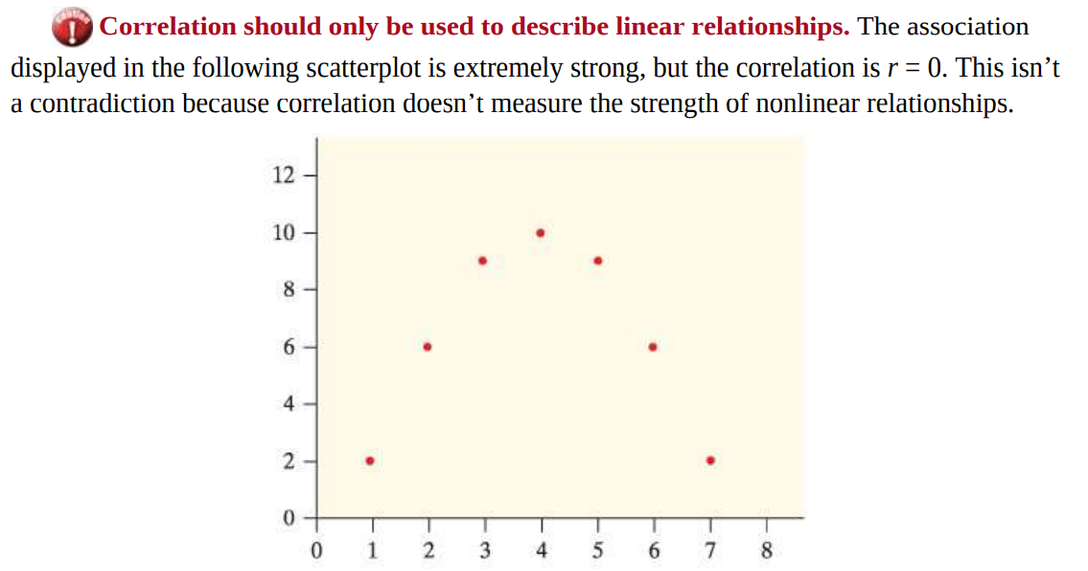
Important cautions

Slide 5
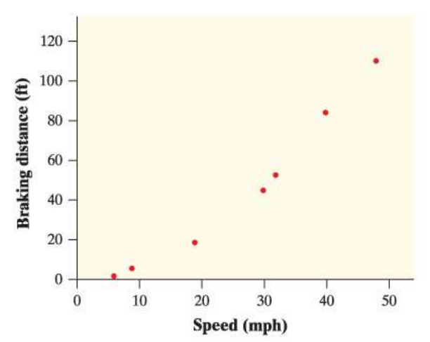

Important cautions
Correlation does not measure form.
Here is a scatterplot showing the speed (in miles/hour) and the distance (in feet) needed to come to a complete stop when a motorcycle’s brake was applied.
The association is clearly curved, but the correlation is quite large: r = 0.98.

Slide 6
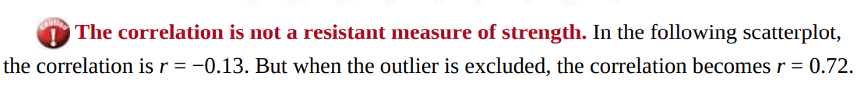
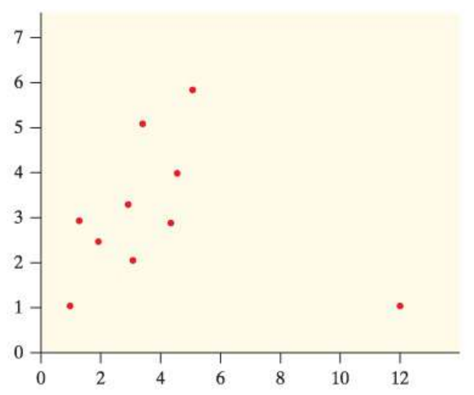
Important cautions
The correlation can be greatly influenced by outliers.

Slide 7
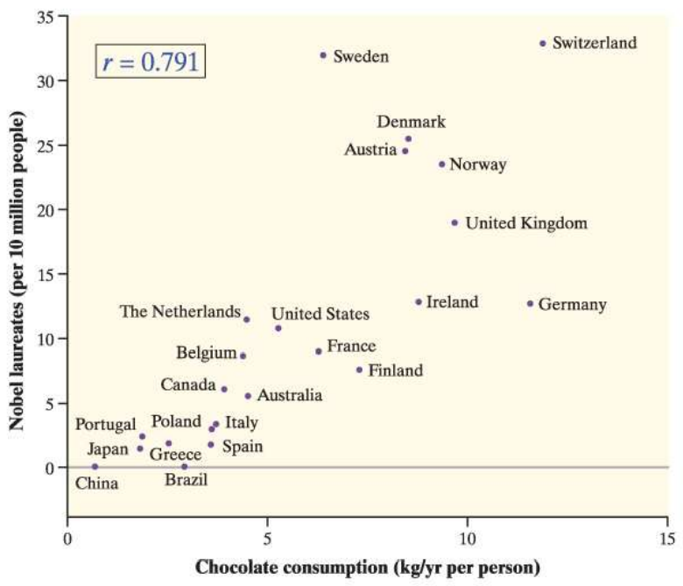
Correlation & Causation
Most people love chocolate for its great taste. But does it also make you smarter?
A scatterplot like this one recently appeared in the New England Journal of Medicine.
The explanatory variable is the chocolate consumption per person for a sample of countries.
The response variable is the number of Nobel Prizes per 10 million residents of that country.
Q.a. :
If people in the United States started eating more chocolate, could we expect more Nobel Prizes to be awarded to residents of the United States? Explain.
Q.b. :
What effect does Switzerland have on the correlation? Explain.

Slide 8
Correlation & Causation
Most people love chocolate for its great taste. But does it also make you smarter?
A scatterplot like this one recently appeared in the New England Journal of Medicine.
The explanatory variable is the chocolate consumption per person for a sample of countries.
The response variable is the number of Nobel Prizes per 10 million residents of that country.
Q.a. :
If people in the United States started eating more chocolate, could we expect more Nobel Prizes to be awarded to residents of the United States? Explain.
No; even though there is a strong correlation between chocolate consumption and the number of Nobel laureates in a country, causation should not be inferred. It is possible that both of these variables are changing due to another variable, such as per capita income.

Slide 9
Correlation & Causation
Most people love chocolate for its great taste. But does it also make you smarter?
A scatterplot like this one recently appeared in the New England Journal of Medicine.
The explanatory variable is the chocolate consumption per person for a sample of countries.
The response variable is the number of Nobel Prizes per 10 million residents of that country.
Q.b. :
What effect does Switzerland have on the correlation? Explain.
When Switzerland is included with the rest of the points, it makes the association stronger because it doesn’t vary much from the linear pattern. This makes the correlation closer to 1.

Slide 10
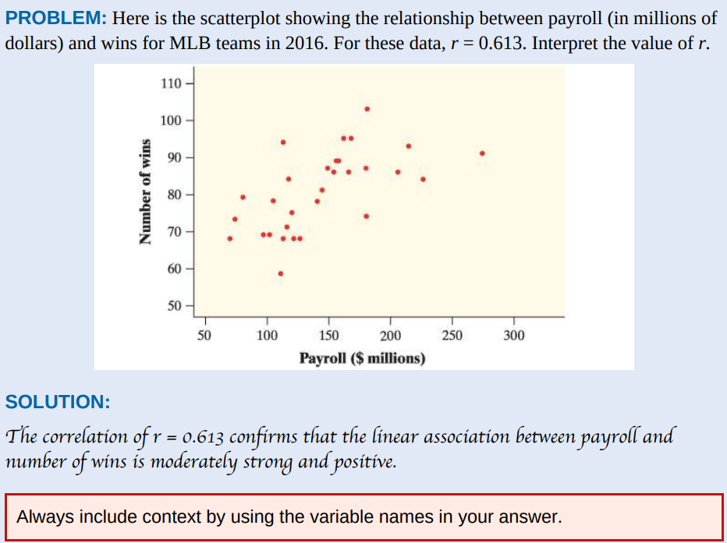
Interpret the correlation coefficient

Slide 11
Interpret the correlation coefficient

Slide 12
